Slide 1

Tech Hunters
MQTT Shield
Security Analysis and Vulnerability Detection
in MQTT-Based IoT Systems (PS10)

Slide 2
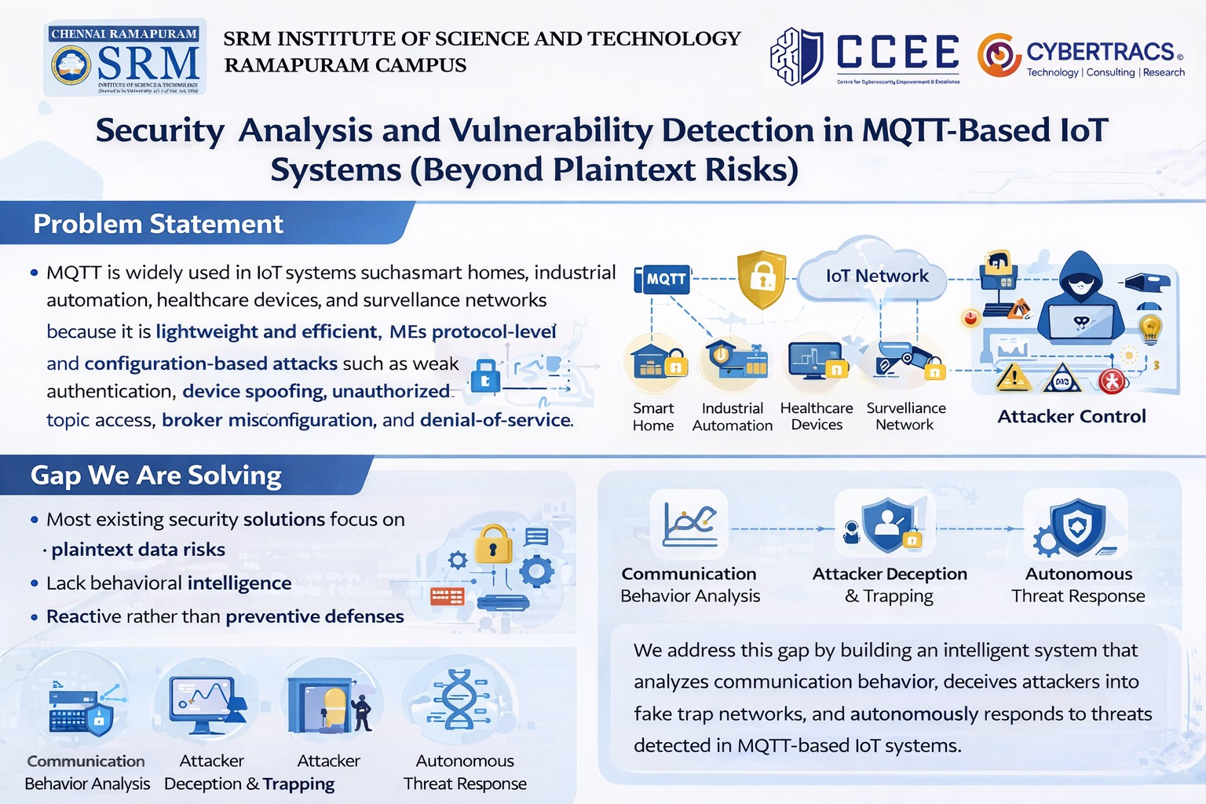

Slide 3
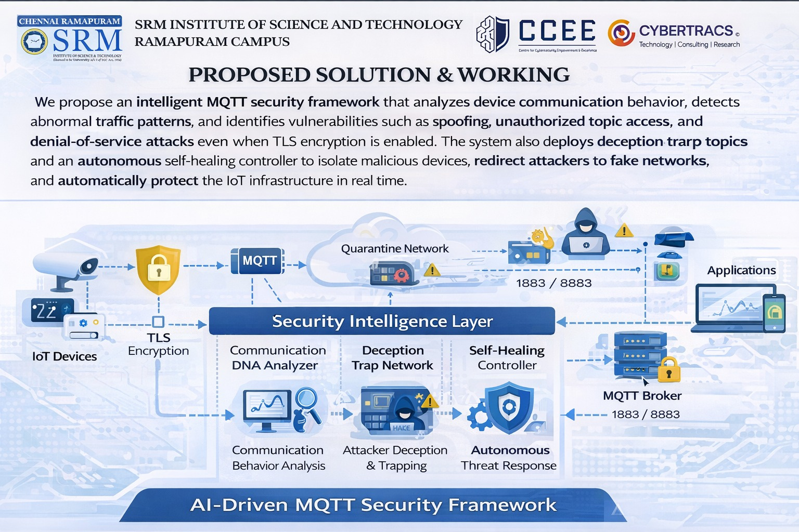

Slide 4
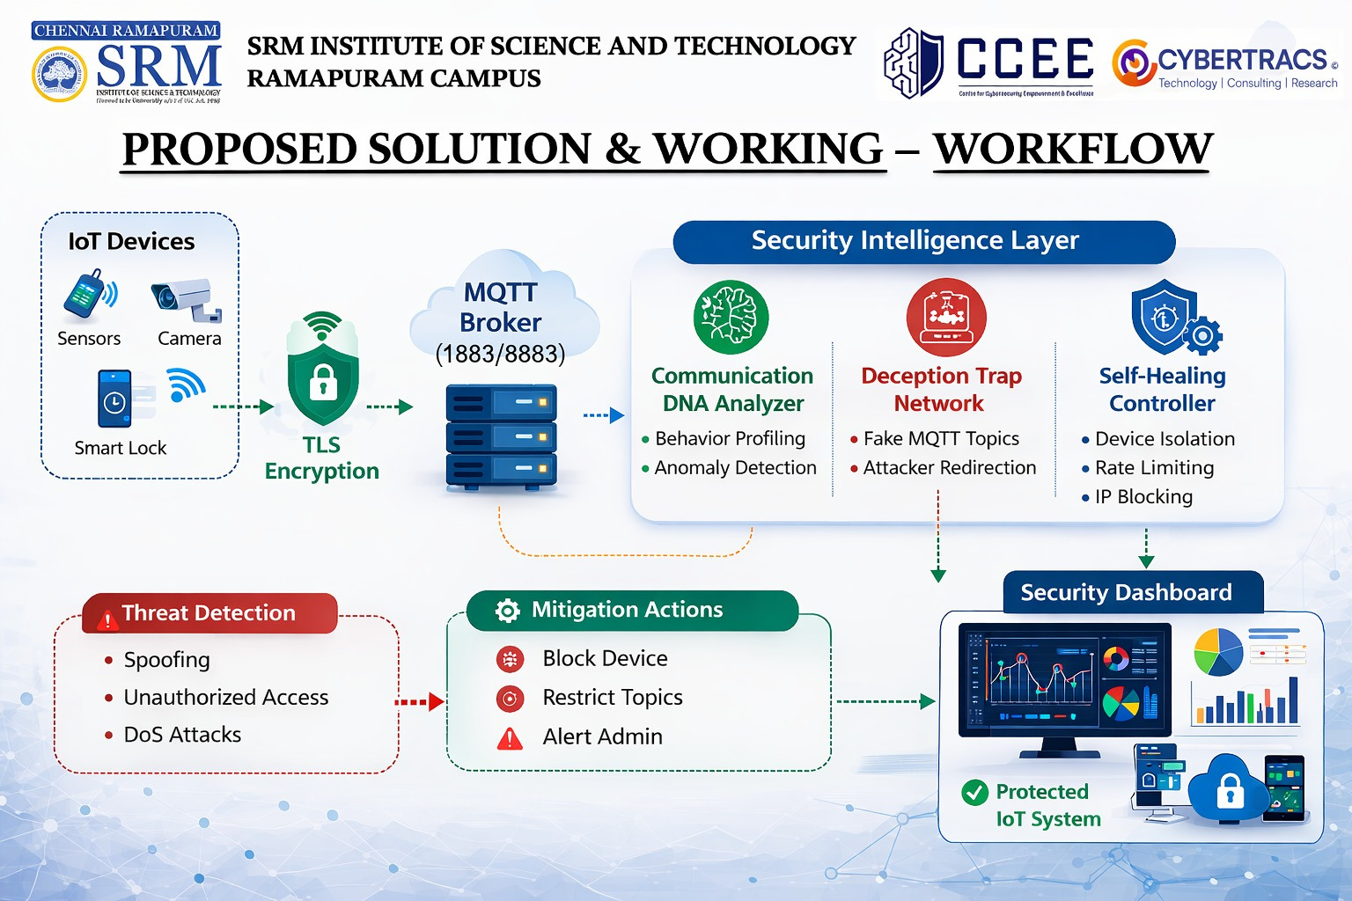

Slide 5
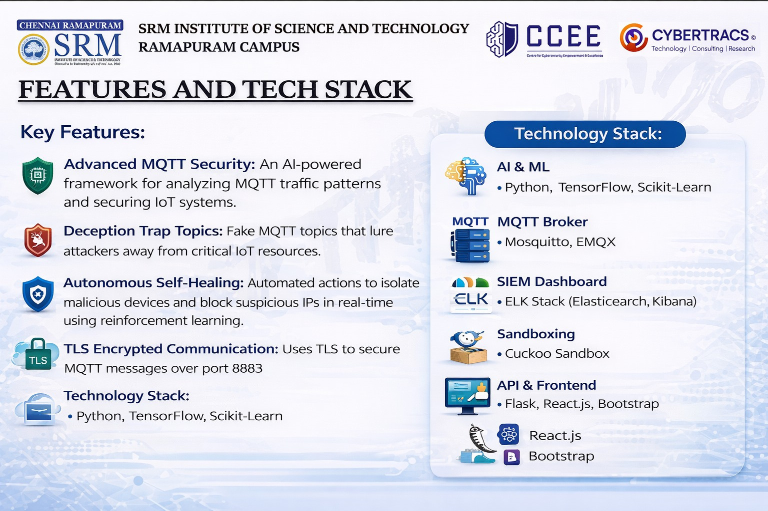

Slide 6
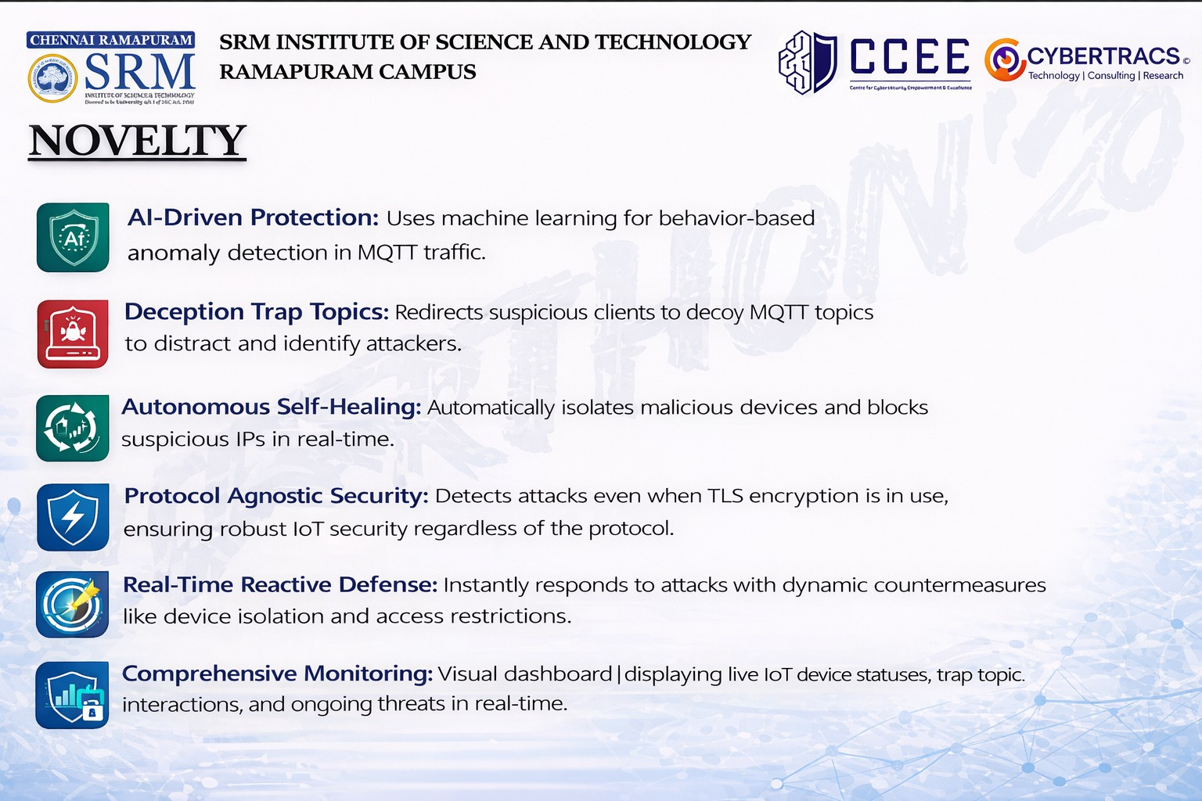

Slide 7


